Slide 1
Photo Credit: Kanyi Daily News
Edafe Okporo got married this summer during pride month, and it is a celebration to remember.
Edafe Okporo’s Challenge Out of Nigeria and Into America
Have you ever been discriminated against for something that you can’t control? Edafe Okporo has, but even farther than you might think discrimination goes. When he was living in Nigeria, he was one day awoken by his neighbors pounding on his door and yelling, “Open the door! We know you are gay, and we are going to kill you!”
He went off to the US out of fright, where he then spent 5 months in an immigration detention center. Once he got out, he was offered no help without him finding it by himself.
He has now settled down, and wrote a memoir about his struggle of immigration. He has also gotten married this summer, despite what he may have thought would have happened in Nigeria.
He is now helping organizations for immigrants, and have even created one himself for specifically LGBTQ+ immigrants like him.
Notes:
Use this template for students to create their profile of a refugee.

Slide 2
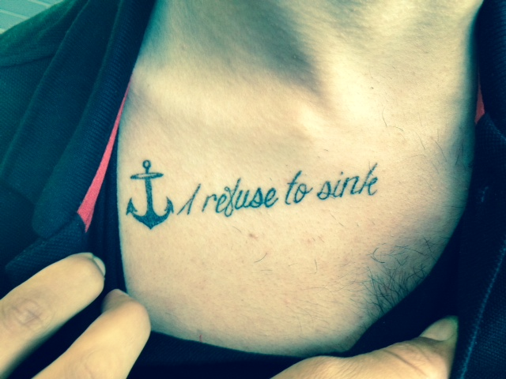
Photo by A. Spanaki/2014, UNHCR
As Houssein watched his life slip away in Syria, he vowed, “I refuse to sink.”
Houssein’s Story:
Syrian Refugee
250, 000 dead. 11 million displaced. Unfortunately, Houssein’s tragic refugee story is all too common in Syria.
Houssein was an average college student with his future ahead of him. As civil war began to rage through Syria, Houssein said goodbye to friends and family who were running from war. At first, Houssein refused to leave his home. He had heard traumatic stories of refugees running from their homes, boarding rubber raft boats, and drowning in the Mediterranean Sea.
However, as life became more and more dangerous in Syria, Houssein was soon left with no choice. He had to flee. Before he left, he made himself a promise in the form of a tattoo. His tattoo reads, “I refuse to sink.”
True to his word, Houssein survived the treacherous journey across the Mediterranean Sea to Greece. He would later learn that the same day he reached safety, another ship full of refugees capsized, killing all on board.
Even though Houssein has lost everything, among refugees, he is considered lucky.
Notes:
SAMPLE

Slide 3
The Refugee Profile Rubric
Criteria | Stand-ard | 5: Mastery | 4: Very Good | 3: Almost There | 2: Developing | 1: Needs Improvement
CONTENT AND ANALYSIS: the extent to which the essay conveys complex ideas and information clearly and accurately in order to support claims in an analysis of topics or texts | W.2 R.1–9 | —clearly introduce a topic in a manner that is compelling and follows logically from the task and purpose —demonstrate insightful analysis of the text(s) | clearly introduce a topic in a manner that follows from the task and purpose —demonstrate grade-appropriate analysis of the text(s) | —introduce a topic in a manner that follows generally from the task and purpose —demonstrate a literal comprehension of the text(s) | —introduce a topic in a manner that does not logically follow from the task and purpose —demonstrate little understanding of the text(s) | —demonstrate a lack of comprehension of the text(s) or task
COMMAND OF EVIDENCE: the extent to which the essay presents evidence from the provided texts to support analysis and reflection | W.9 R.1–9 | —develop the topic with relevant, well-chosen facts, definitions, concrete details, quotations, or other information and examples from the text(s) and/or from your life —sustain the use of varied, relevant evidence | develop the topic with relevant facts, definitions, details, quotations, or other information and examples from the text(s) and/or from your life —sustain the use of relevant evidence, with some lack of variety | —partially develop the topic of the essay with the use of some textual evidence and/or personal examples, some of which may be irrelevant —use relevant evidence with inconsistency | —demonstrate an attempt to use evidence, but only develop ideas with minimal, occasional evidence which is generally invalid or irrelevant | —provide no evidence or provide evidence that is completely irrelevant
COHERENCE, ORGANIZATION, AND STYLE: the extent to which the essay logically organizes complex ideas, concepts, and information using formal style and precise language | W.2 L.3 L.6 | —exhibit clear organization, with the skillful use of appropriate and varied transitions to create a unified whole and enhance meaning —establish and maintain a formal style, using grade-appropriate, stylistically sophisticated language and domain-specific vocabulary with a notable sense of voice —provide a concluding statement or section that is compelling and follows clearly from the topic and information presented | —exhibit clear organization, with the use of appropriate transitions to create a unified whole —establish and maintain a formal style using precise language and domain-specific vocabulary —provide a concluding statement or section that follows from the topic and information presented | —exhibit some attempt at organization, with inconsistent use of transitions —establish but fail to maintain a formal style, with inconsistent use of language and domain-specific vocabulary —provide a concluding statement or section that follows generally from the topic and information presented | —exhibit little attempt at organization, or attempts to organize are irrelevant to the task —lack a formal style, using language that is imprecise or inappropriate for the text(s) and task —provide a concluding statement or section that is illogical or unrelated to the topic and information presented | —exhibit no evidence of organization —use language that is predominantly incoherent or copied directly from the text(s) —do not provide a concluding statement or section
CONTROL OF CONVENTIONS: the extent to which the essay demonstrates command of the conventions of standard English grammar, usage, capitalization, punctuation, and spelling | W.2 L.1 L.2 | —demonstrate grade-appropriate command of conventions, with few errors | —demonstrate grade-appropriate command of conventions, with occasional errors that do not hinder comprehension | —demonstrate emerging command of conventions, with some errors that may hinder comprehension | —demonstrate a lack of command of conventions, with frequent errors that hinder comprehension | —are minimal, making assessment of conventions unreliable

